Slide 1
Online food ordering system
By : Rafiullah & Uzair ullah

Slide 2
introduction
cafe or restaurant or food ordering system is being created to support all cafe and restaurants that faces the same issues for a very long time. The food ordering system helps your cafe, restaurants and business in many ways. It makes your business grow, it helps your business target more audiences and it increases your business sales and provides quality services in a timely manner.

Slide 3

Splash Activity
The user clicks on the icon,
Splash activity is loaded
The first activity

Slide 4
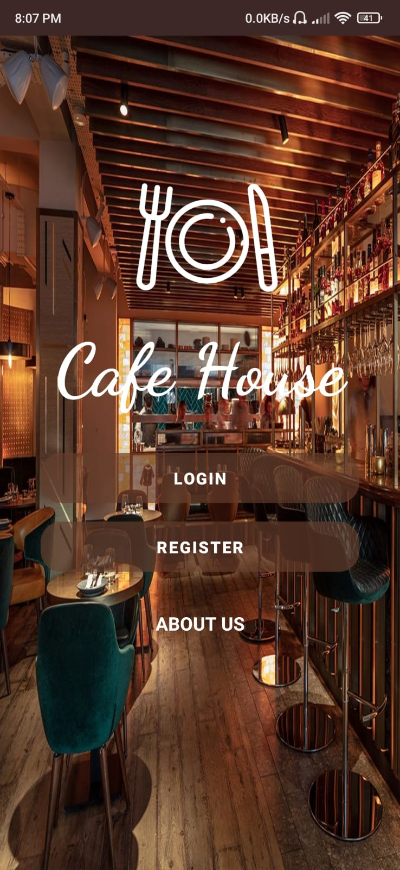
2nd activity (Main Activity)
The main menue activity
The user chooses to (Log in, Register)

Slide 5
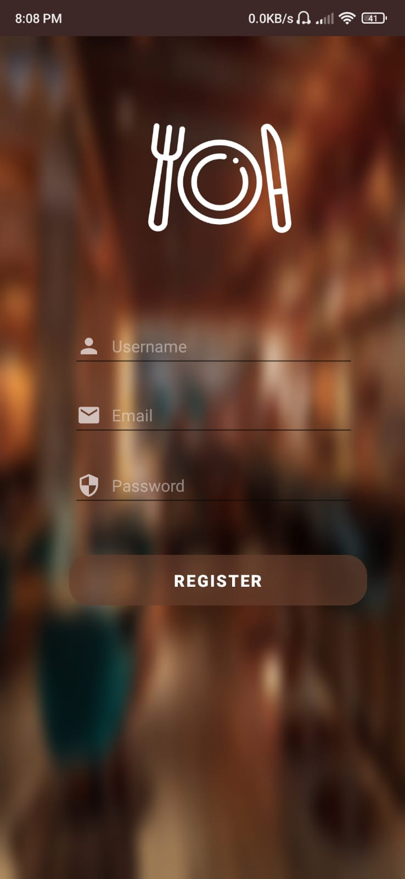
3rd Activity (Register Activity)
The register activity receives
name
Email
Password
The data is stored in firebase database,
And user is successfully registered.

Slide 6
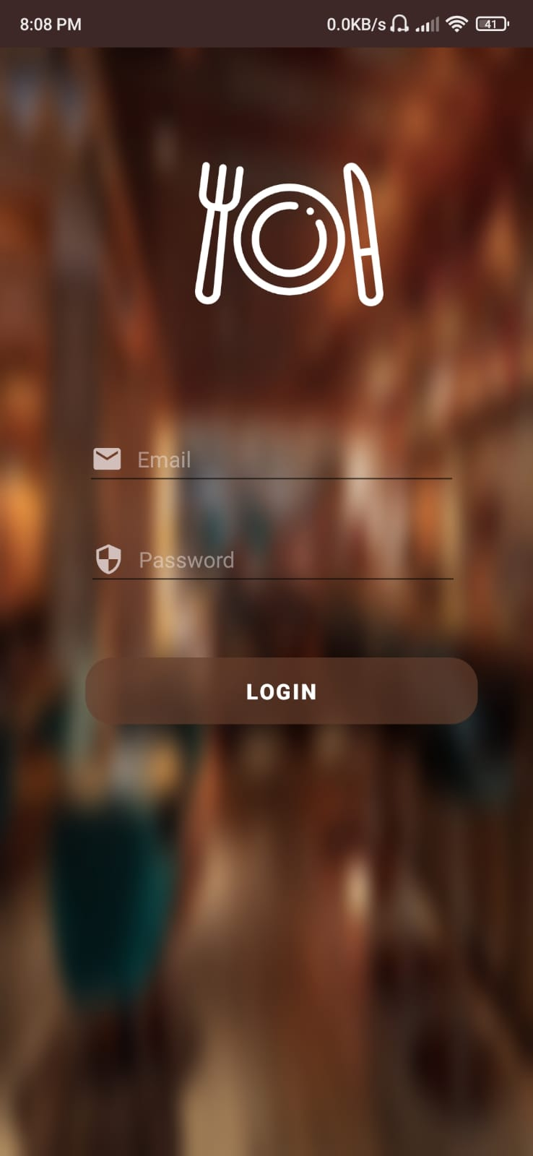
4th Activity (Log in Activity)
The user enters (Emal and password)
The cridintials are matched in firebase
Database, if valid it will be redirected
To the menue Activity.

Slide 7
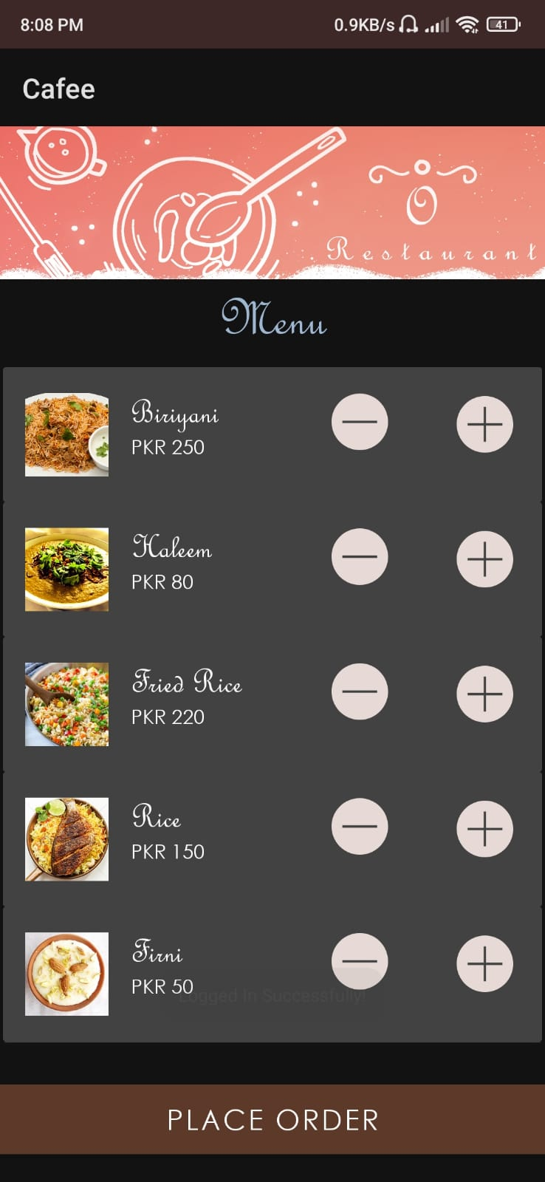
5th Activity (Menu Activity )
The user receives menu Activity,
The user adds items to the list
And clicks on place order.

Slide 8
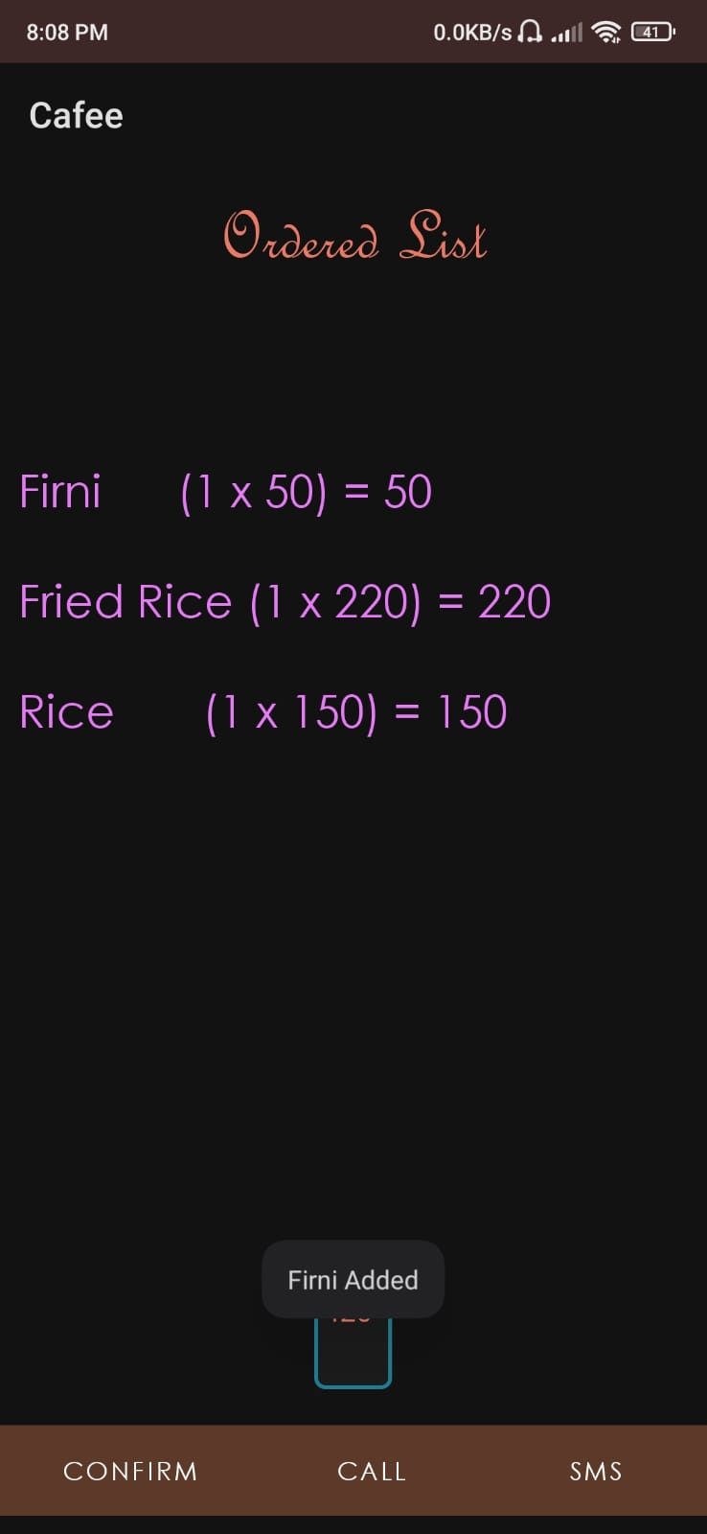
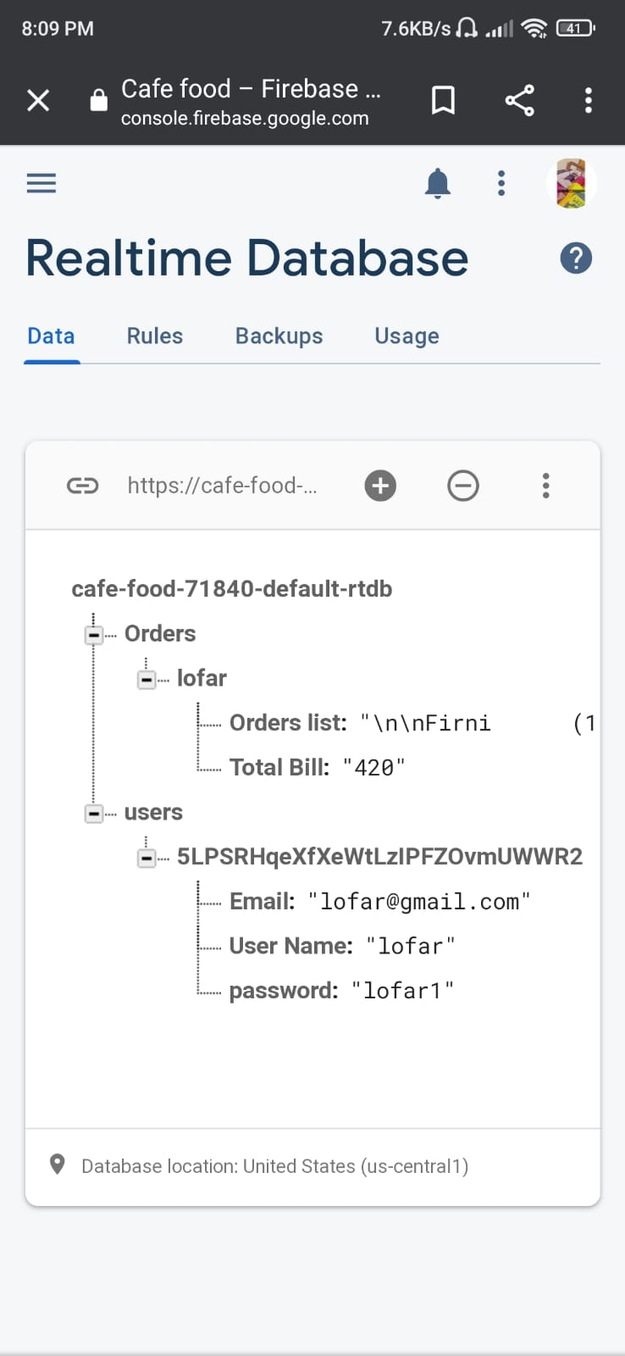
6th Activity (Confirmation)
Here user see all choosen items,
The user confirm the order or directly
Call or sms the Restaurant.

Slide 9
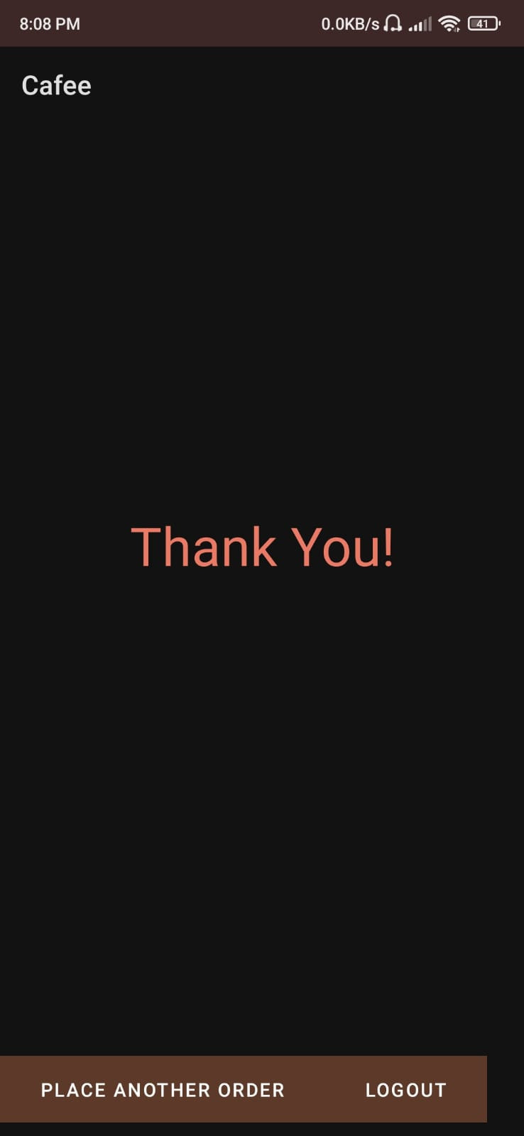
7th Activity ( Thanks )
Thank you Activity is displayed
When user confirms the order
Also user can choose to place another
Order or log out from the app.

Slide 10
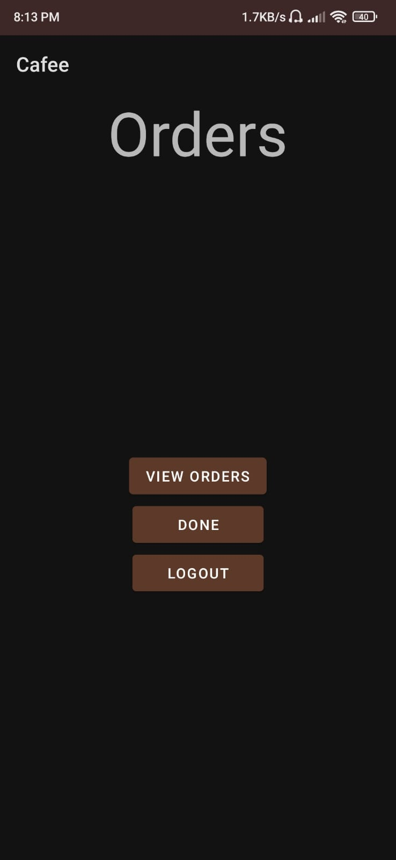
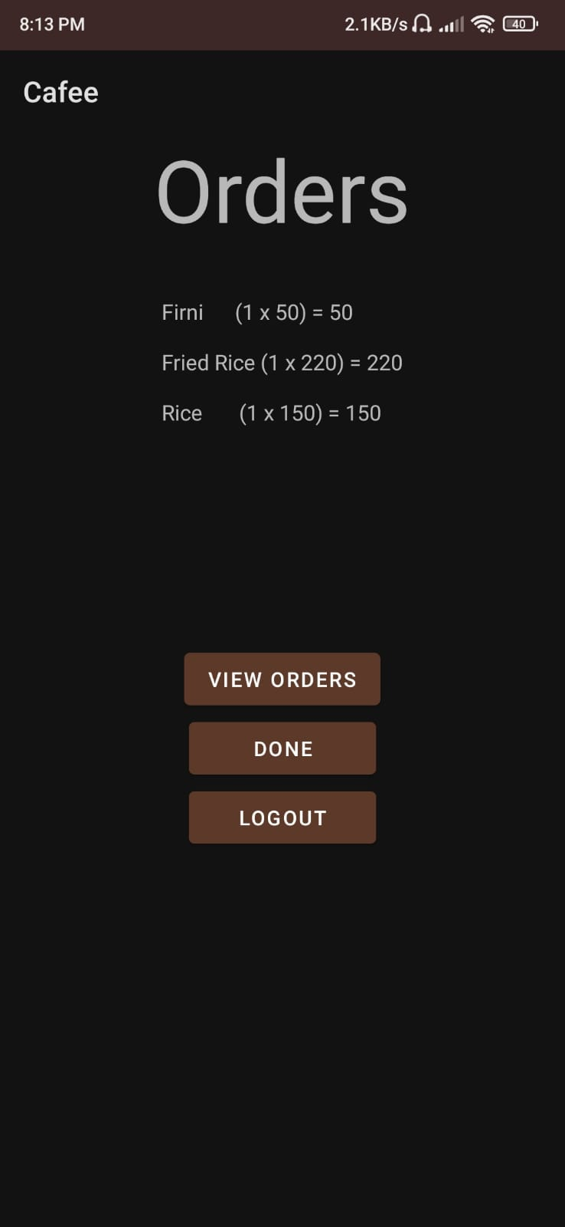
8th Activity (Admin)
The Admin activity reads all the
Orders from the firebase real time
Database, and prepare the order
Accordingly.

